Slide 1
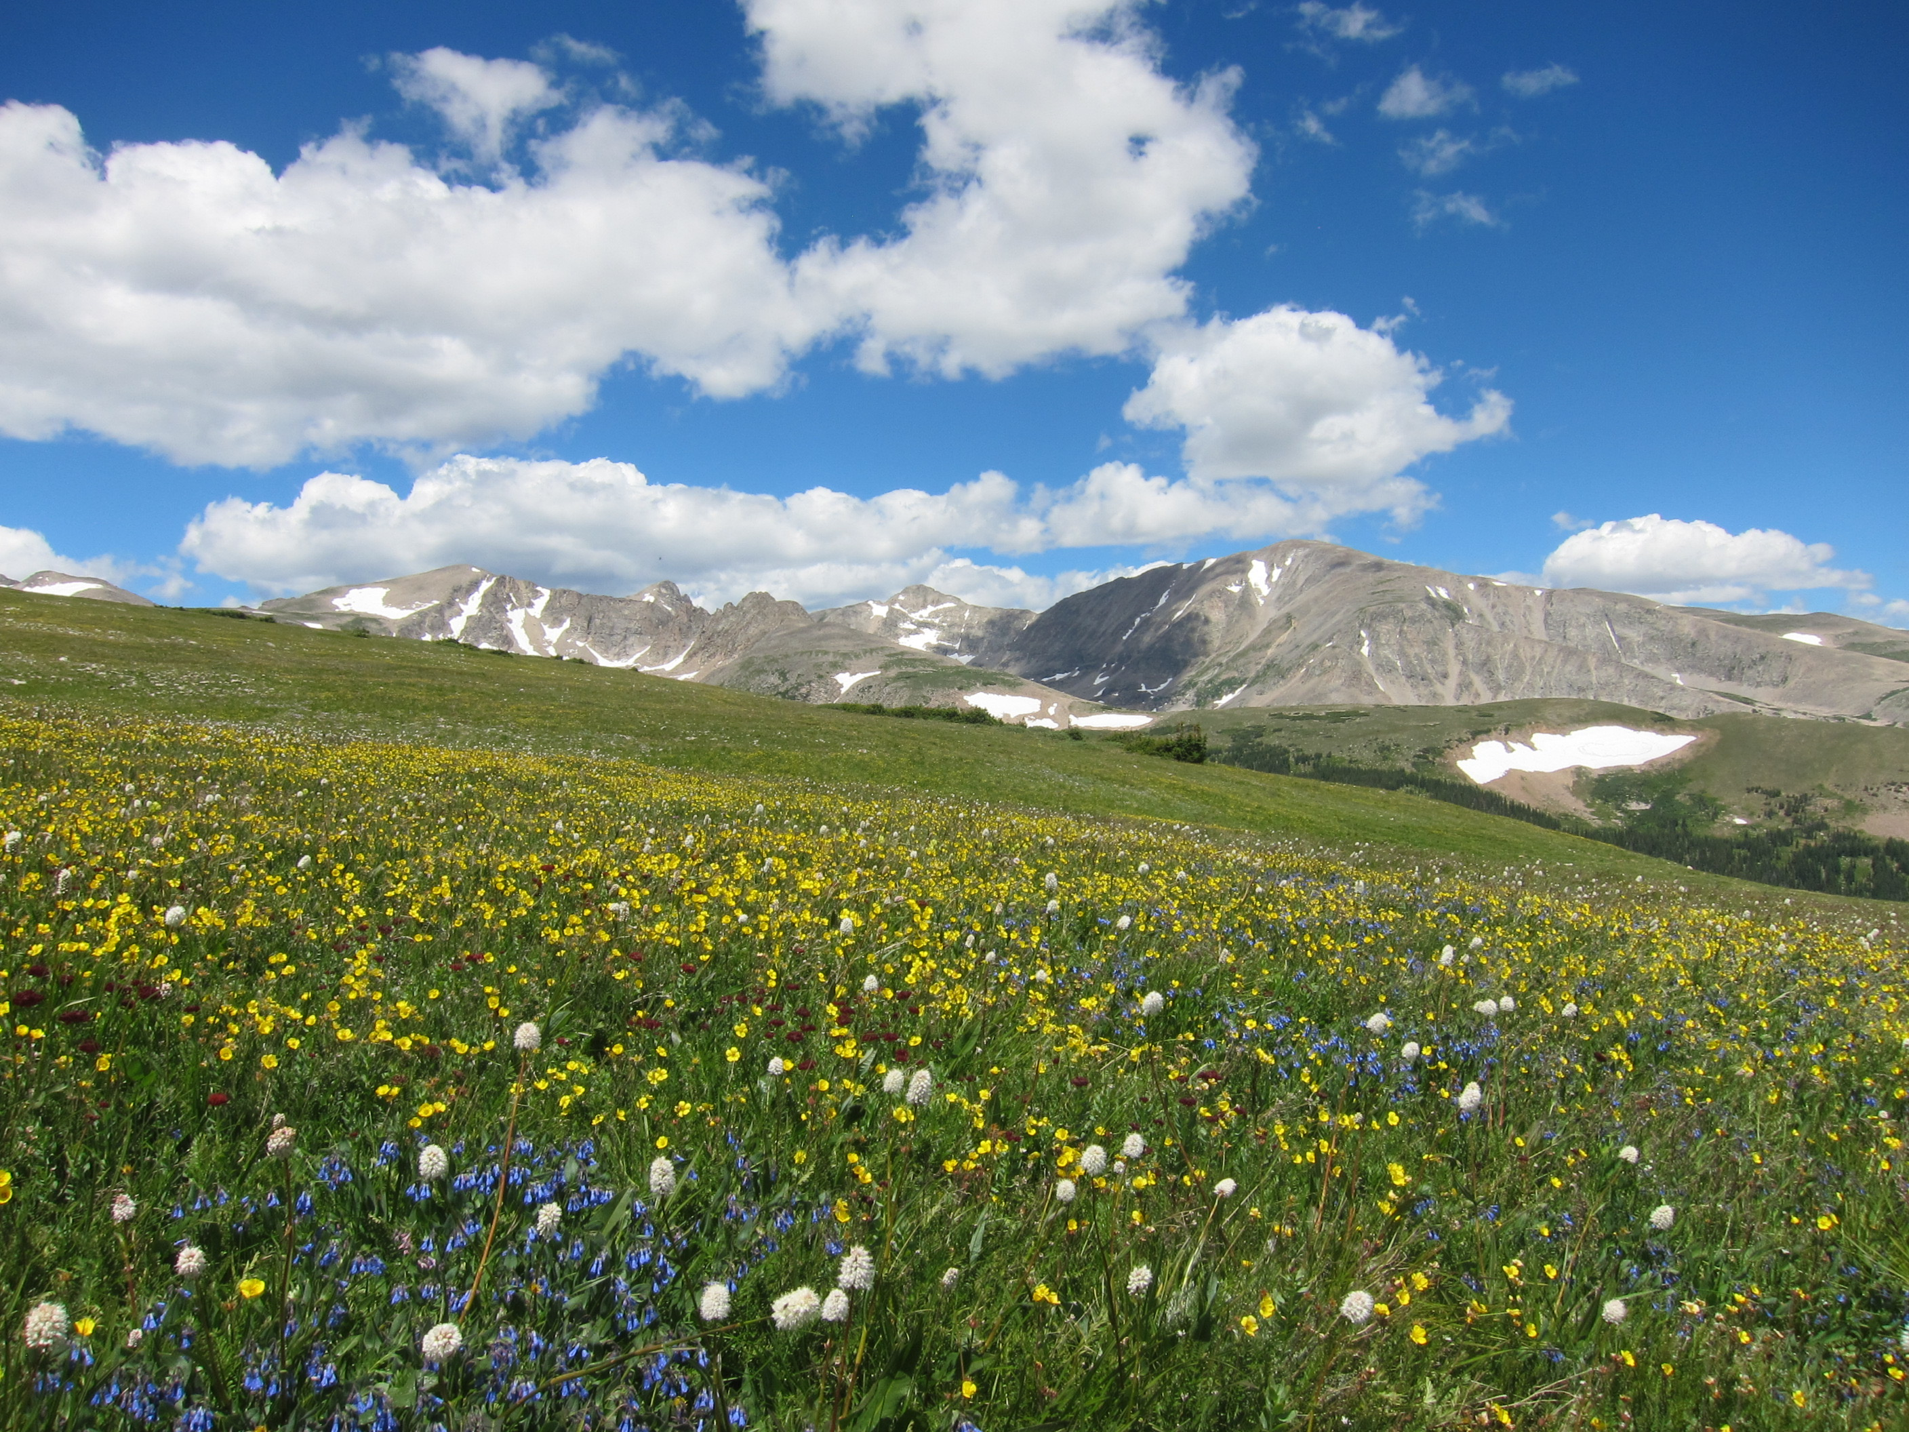
How does removal of a dominant species alter community response to nitrogen addition? Laurel Brigham

Slide 2
Motivation and Background
Communities across the globe are experiencing ecological presses, such as nitrogen (N) deposition, that are causing shifts in community structure and function.
Dominant species have a disproportionate influence on the community through species interactions and nutrient dynamics.
The response of these dominants to the ecological press may then shape the community response.

Slide 3
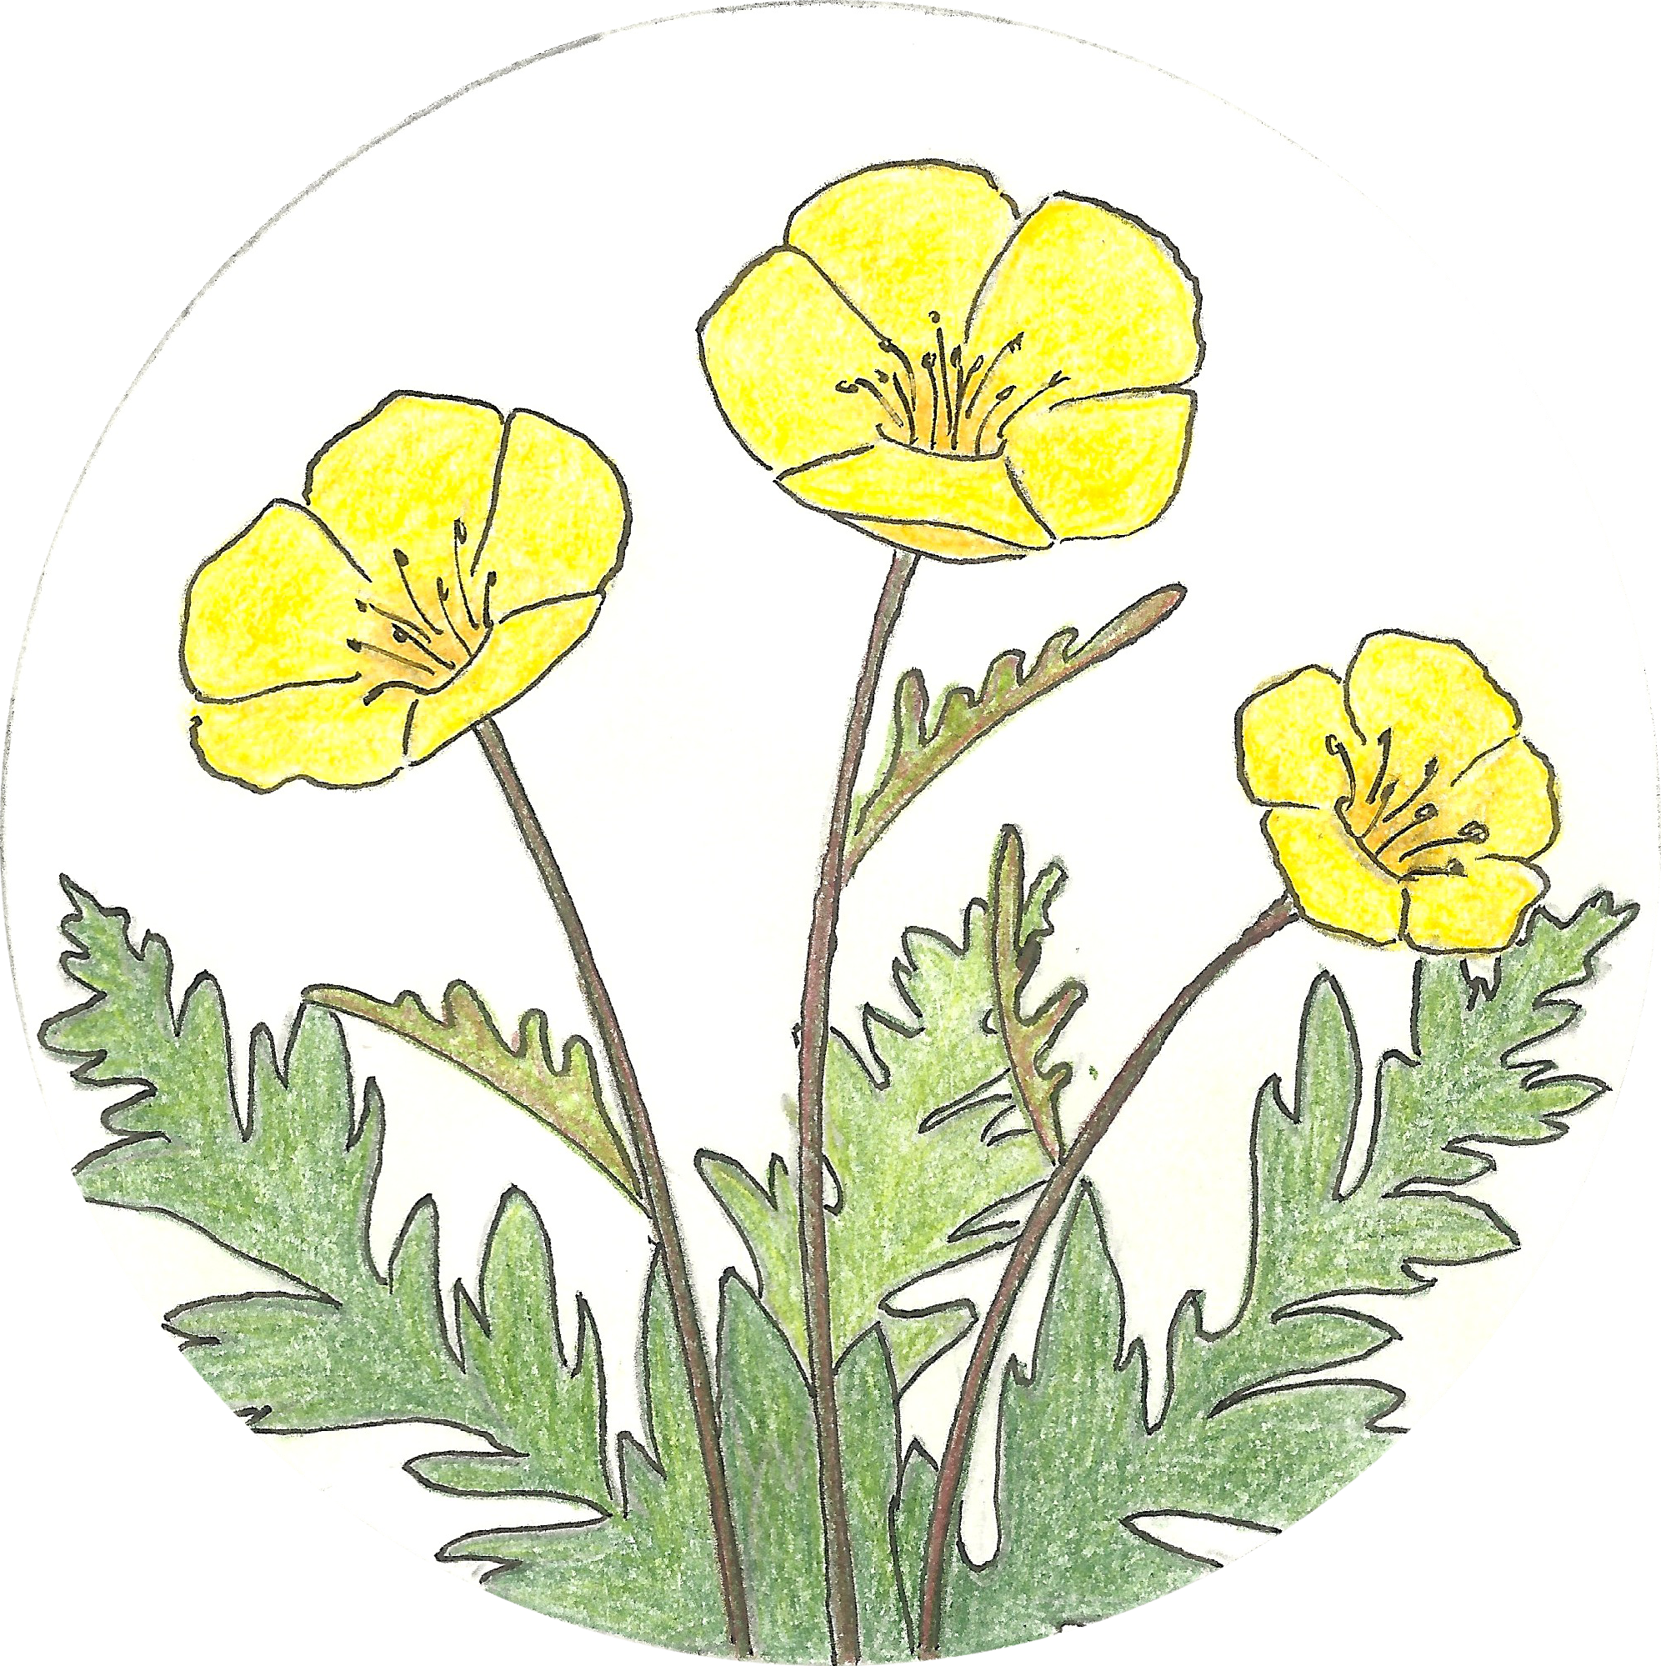
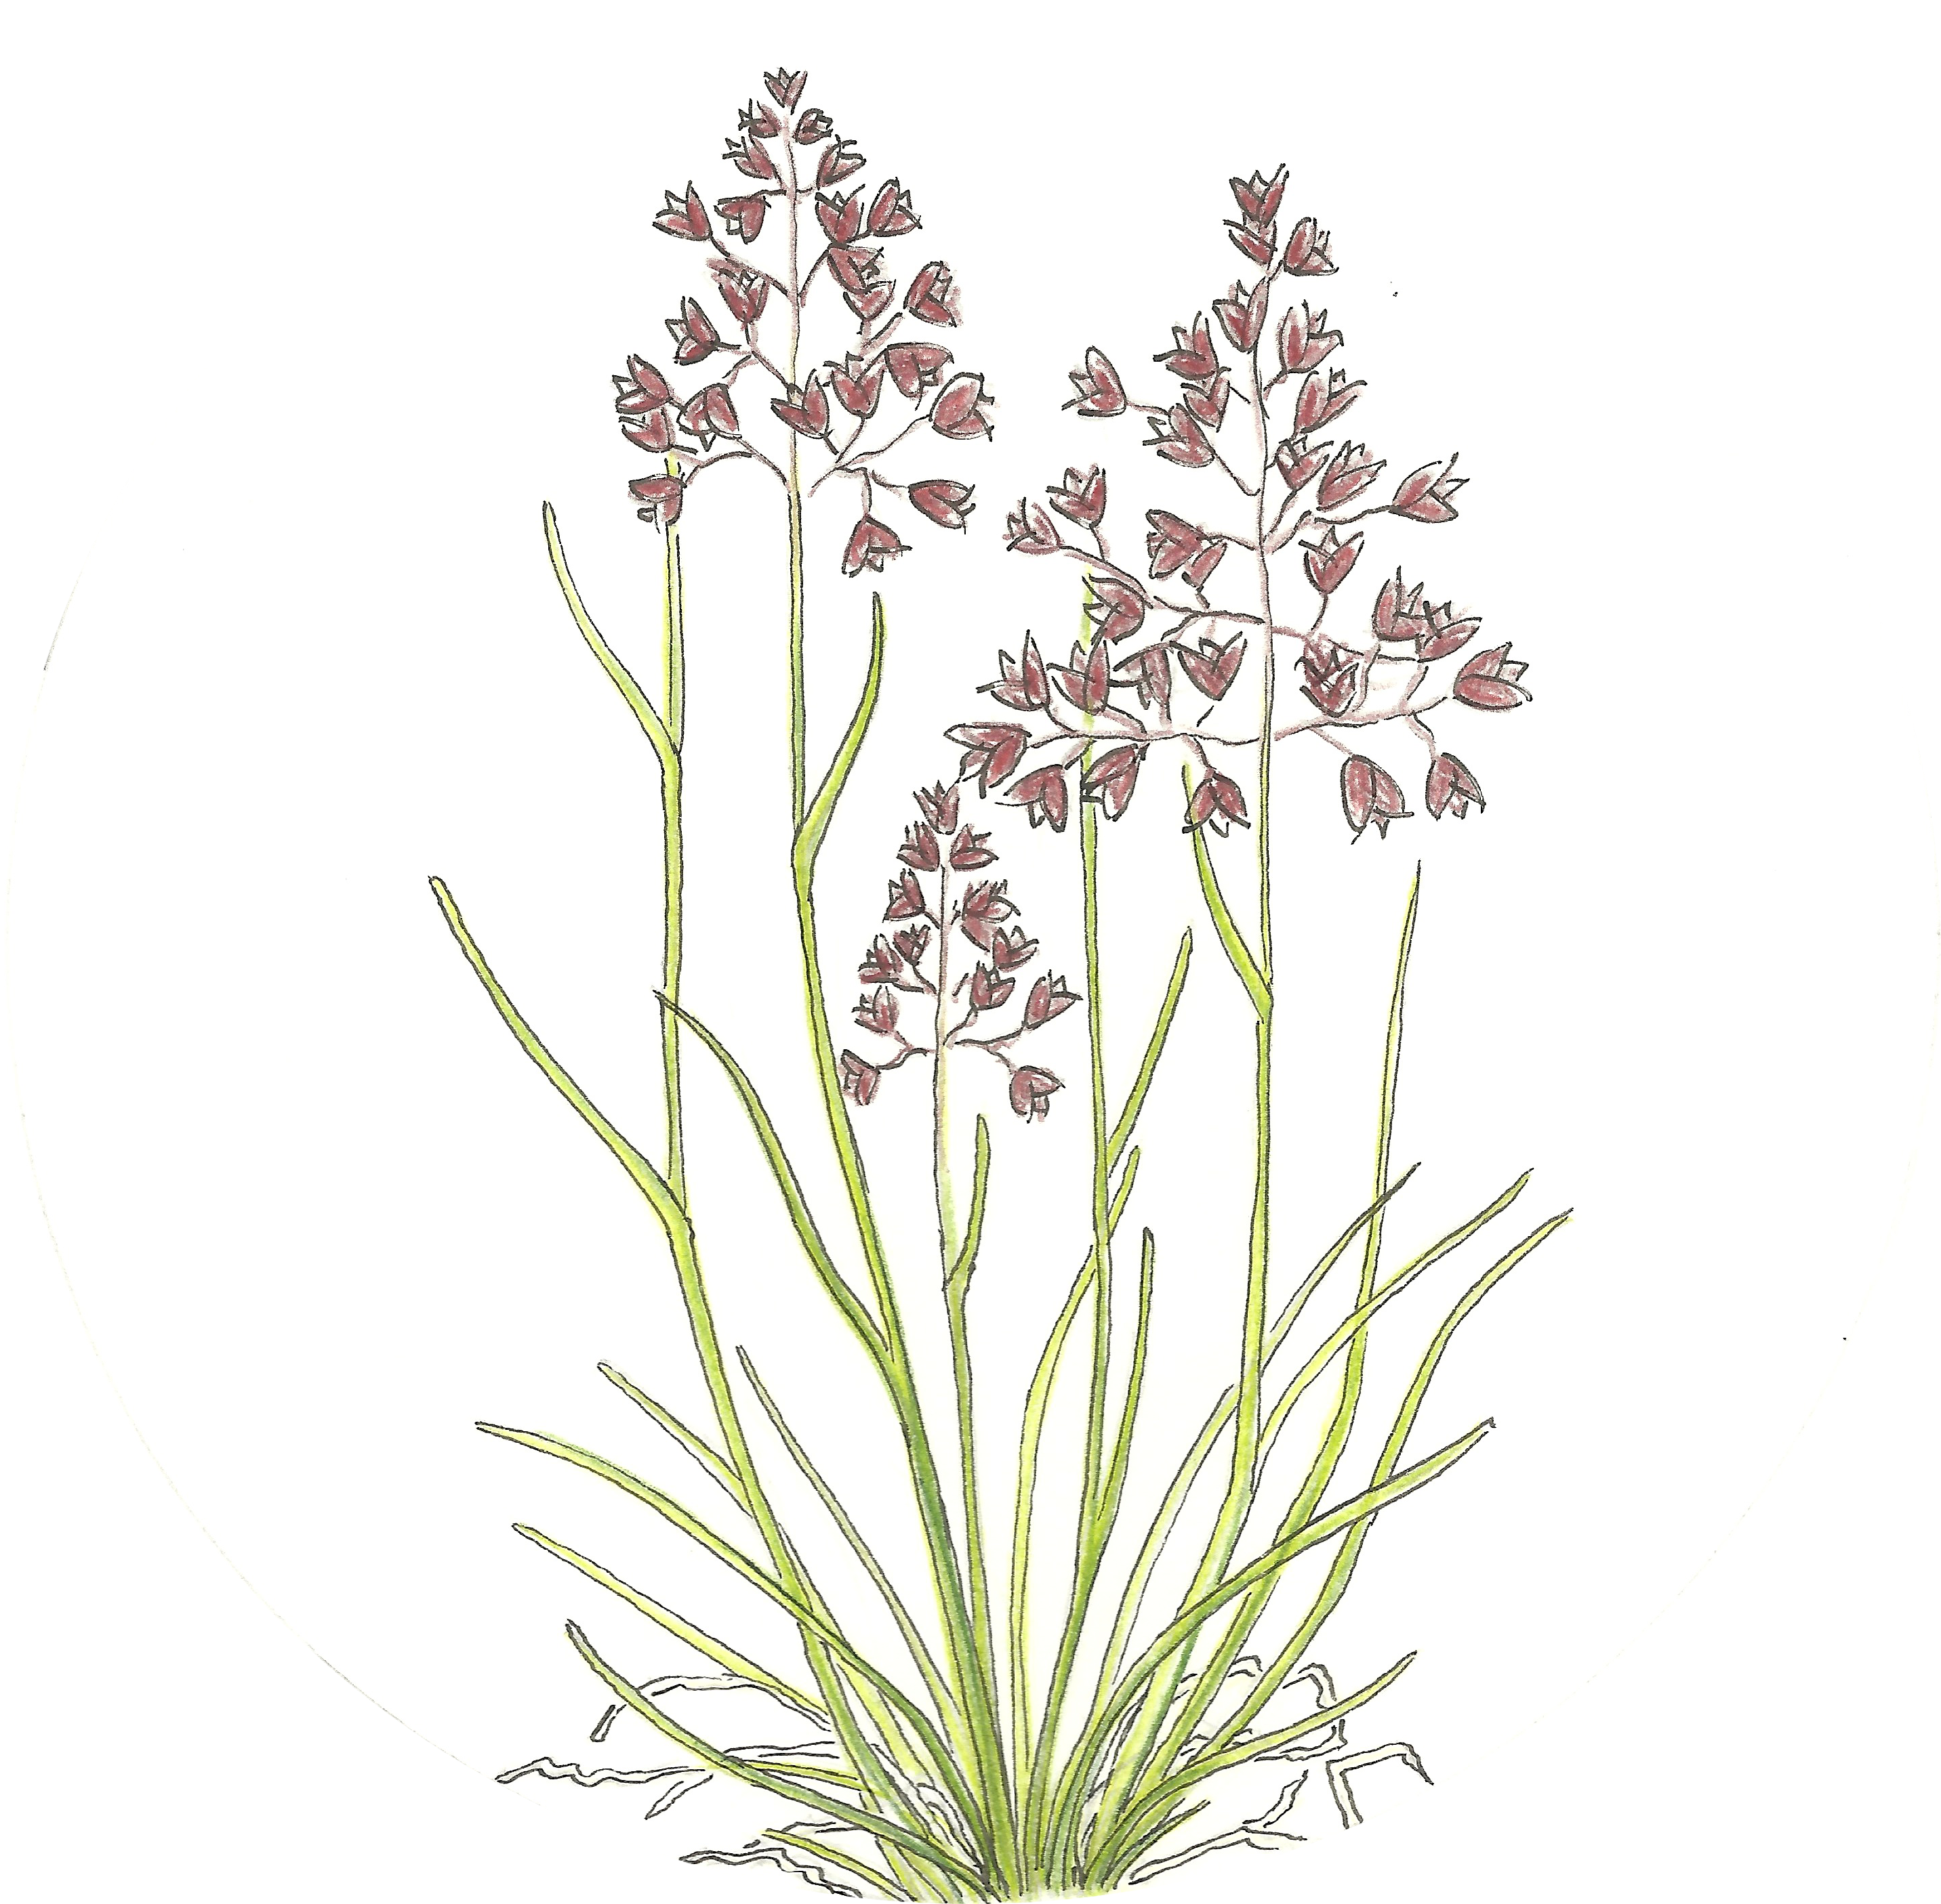
Approach
System: Moist meadow at Niwot Ridge, CO
Duration: 2002-2018
Experimentally manipulated the plant community by removing dominant species
Either Deschampsia cespitosa (bunchgrass) or Geum rossii (forb)
Nitrogen Addition
None
Removal
No Addition
None

Slide 4
About the Data
1127 rows and 71 columns
42 plots resampled over 16 years
Site (7) to be used as a blocking factor

Slide 5
Anticipated Details
I will analyze temporal diversity trends and overall effects
Richness
Rate and direction of community change
Community composition shifts

Slide 6
Anticipated Results
Dominant species removal will have differing impacts on the community response to N, based on the identity of the species
Deschampsia is a fast N cycler while Geum is a slow N cycler, their loss will have different effects depending on how/if the community compensates

